Slide 1
Maximum Power Transfer Theorem

Slide 2
9.5 Maximum Power Transfer Theorem
When designing a circuit, it is often important to be able to answer one of the following questions:
What load should be applied to a system to ensure that the load is receiving maximum power from the system?
and, conversely:
For a particular load, what conditions should be imposed on the source to ensure that it will deliver the maximum power available?
Why is it helpful to have some idea of the value that will draw maximum power?
If a design calls for a load of 100Ω which will draw maximum power, to ensure that the load receives maximum power, using a resistor of 1Ω or 1 kΩ results in a power transfer that is much less than the maximum possible.
However, using a load of 82Ω or 120Ω probably results in a fairly good level of power transfer.

Slide 3
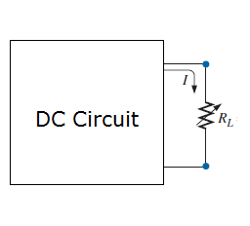
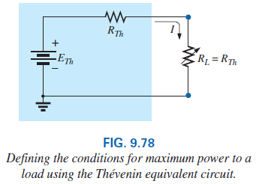
9.5 Maximum Power Transfer Theorem
Fortunately, the process of finding the load that will receive maximum power from a particular system is quite straightforward due to the Maximum Power Transfer Theorem, which states the following:
A load will receive maximum power from a network when its load resistance is exactly equal to the Thévenin resistance of the network applied to the load. That is, R_{L} = R_{Th}
In other words, for the Thévenin equivalent circuit in Fig. 9.78, when the load is set equal to the Thévenin resistance, the load will receive maximum power from the network.

Slide 4

Example
In a audio system, we require that the maximum power from the audio amplifier should get transfer to this speakers.

Slide 5
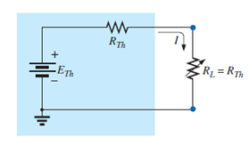
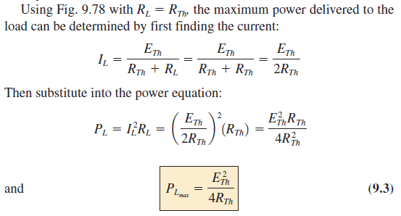
9.5 Maximum Power Transfer Theorem

Slide 6

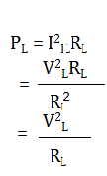
9.5 Maximum Power Transfer Theorem
What value of R_{L} would result in maximum power transfer to R_{L}?
i) Smaller the value of R_{L}; better the current reaches a maximum.
Better the power as it is squared in the power equation P_{L} = I²_{L}R_{L}. The problem is, however, that in the equation the R_{L} is a multiplier. As it gets smaller, it forms a smaller product.
ii) Then,
Larger values of R_{L} , power is increased as V_{L}=I_{L}R_{L}. But, R_{L} is in the denominator of the equation and causes the resulting power to decrease.

Slide 7
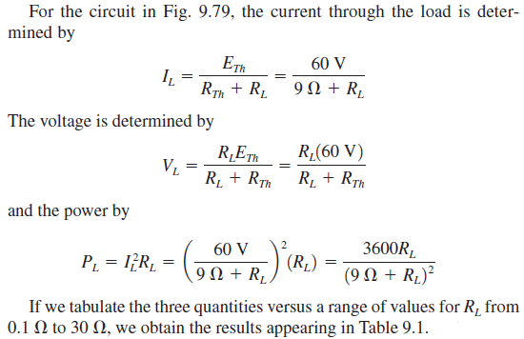
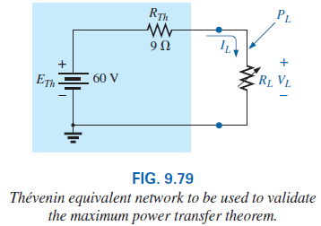
9.5 Maximum Power Transfer Theorem

Slide 8
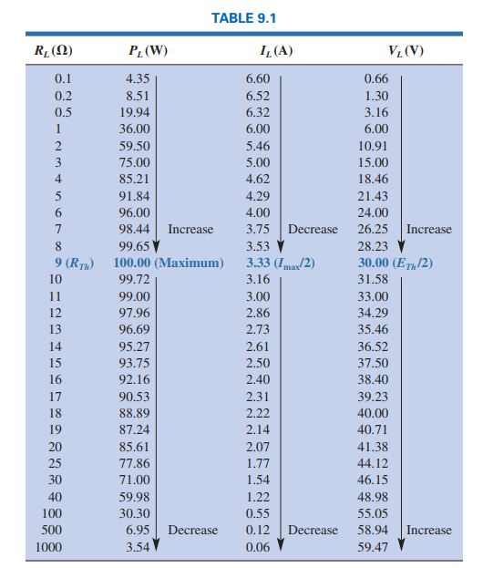

Slide 9
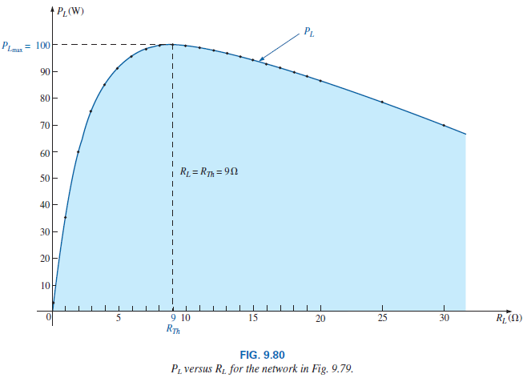
9.5 Maximum Power Transfer Theorem
The power to the load versus the range of resistor values is provided in Fig. 9.80.
P_{L} is maximum when R_{L} = R_{Th} = 9 .
Note in particular that for values of load resistance less than the Thévenin value, the change is dramatic as it approaches the peak value.
However, for values greater than the Thévenin value, the drop is a great deal more gradual.

Slide 10
9.5 Maximum Power Transfer Theorem
The total power delivered by a supply such as E_{Th} is absorbed by both the Thévenin equivalent resistance and the load resistance. Any power delivered by the source that does not get to the load is lost to the Thévenin resistance.
Under maximum power conditions, only half the power delivered by the source gets to the load.
On an efficiency basis, we are working at only a 50% level, but we are pleased because we are getting maximum power out of our system.

Slide 11
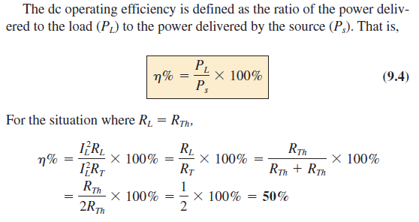
9.5 Maximum Power Transfer Theorem

Slide 12
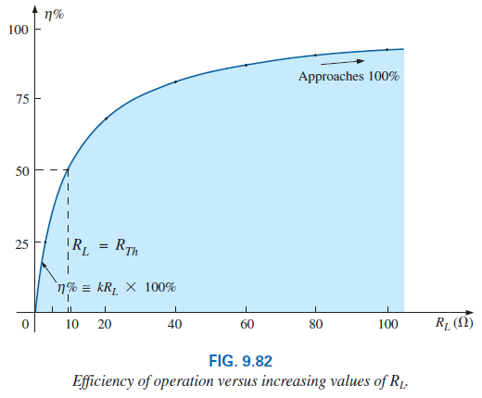
9.5 Maximum Power Transfer Theorem
If we plot the efficiency of operation versus load resistance, we obtain the plot in Fig. 9.82, which clearly shows that the efficiency continues to rise to a 100% level as R_{L} gets larger.
Note in particular that the efficiency is 50% when R_{L} = R_{Th} .

Slide 13
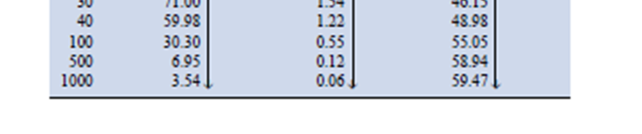
9.5 Maximum Power Transfer Theorem
The efficiency therefore increases linearly and dramatically for small levels of R_{L} and then begins to level off as it approaches the 100% level for very large values of R_{L}.
At efficiency levels approaching 100%, the power delivered to the load may be so small as to have little practical value.
Note the low level of power (only 3.54W) to the load in Table 9.1 when R_{L} =1000 , even though the efficiency level will be

Slide 14
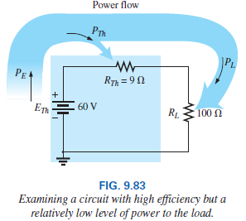
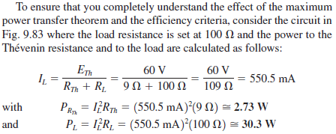

Slide 15
9.5 Maximum Power Transfer Theorem
If efficiency is the overriding/dominant factor, then the load should be much larger than the internal resistance of the supply.
If maximum power transfer is desired and efficiency less of a concern, then the conditions stated by the maximum power transfer theorem should be applied.
A relatively low efficiency of 50% can be tolerated in situations where power levels are relatively low, such as in a wide variety of electronic systems.
However, when large power levels are involved, such as at power generating stations, efficiencies of 50% would not be acceptable.
In fact, a great deal of expense and research is dedicated to raising power generating and transmission efficiencies a few percentage points.
Raising an efficiency level of a 10-mega-kW power plant from 94% to 95% (a 1% increase) can save 0.1 mega-kW, or 100 million watts, of power—an enormous saving- so there efficiency is very important factor.

Slide 16
9.5 Maximum Power Transfer Theorem
If the load resistance is fixed and does not match the applied Thévenin equivalent resistance, then some effort should be made (if possible) to redesign the system so that the Thévenin equivalent resistance is closer to the fixed applied load.

Slide 17
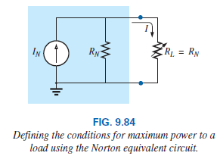
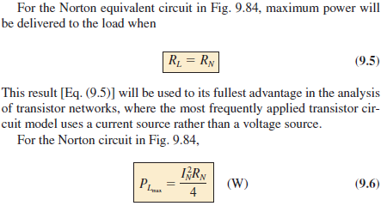
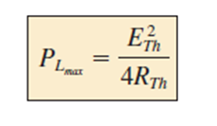


Slide 18
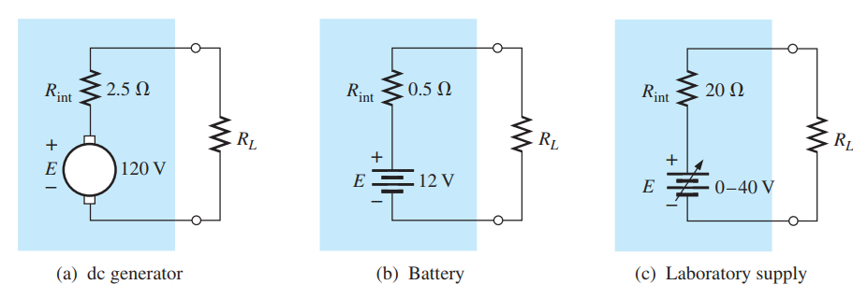

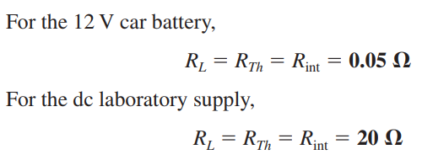

Slide 19

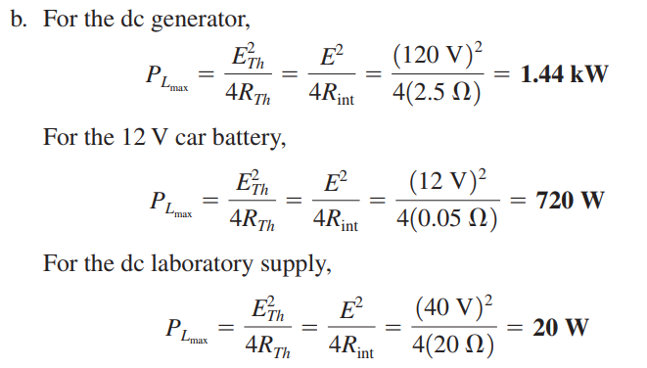

Slide 20
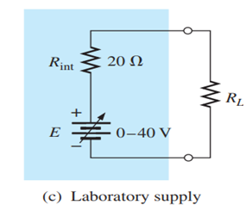
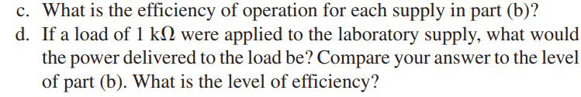
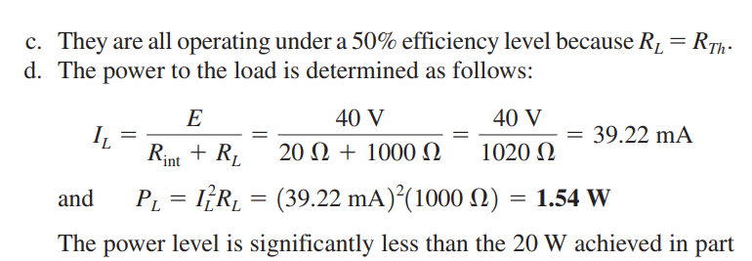
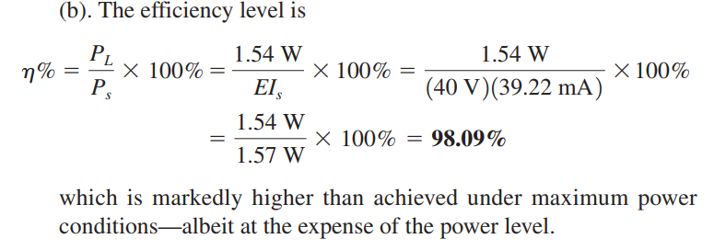

Slide 21
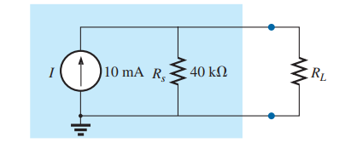
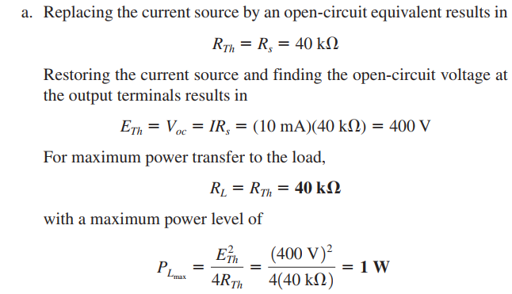

Slide 22

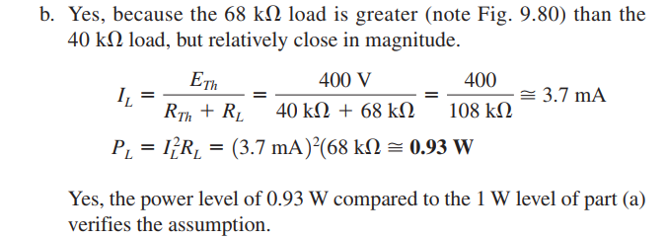

Slide 23

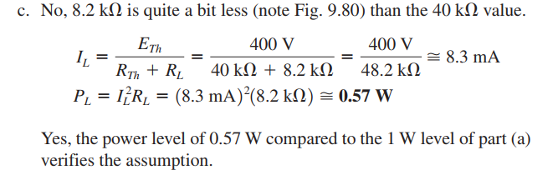

Slide 24
Thank You

